Slide 1


Slide 2
How Water Gets to Our Home | How Water Leaves Our Home | Water in Nature | Water Cycle | Random!
$100 | $100 | $100 | $100 | $100
$200 | $200 | $200 | $200 | $200
$400 | $400 | $400 | $400 | $400
$600 | $600 | $600 | $600 | $600
$800 | $800 | $800 | $800 | $800
$1000 | $1000 | $1000 | $1000 | $1000

Slide 3
An area where large amounts
of water are stored for long
periods of time
Answer

Slide 4
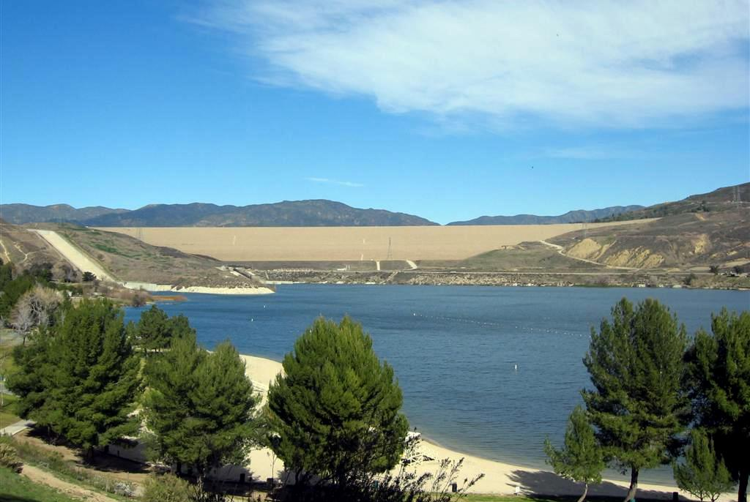

What is a reservoir?

Slide 5
A machine that is used to
bring water uphill, such as
over a mountain
Answer

Slide 6
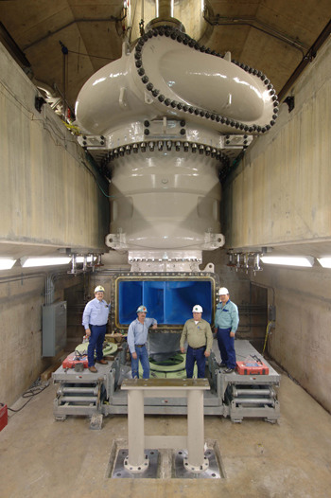
What is a pump?
Notes:
There are other types of pumps, such as those that bring water from out of a well.

Slide 7
A tall building that is used to
store water for humans
Answer

Slide 8
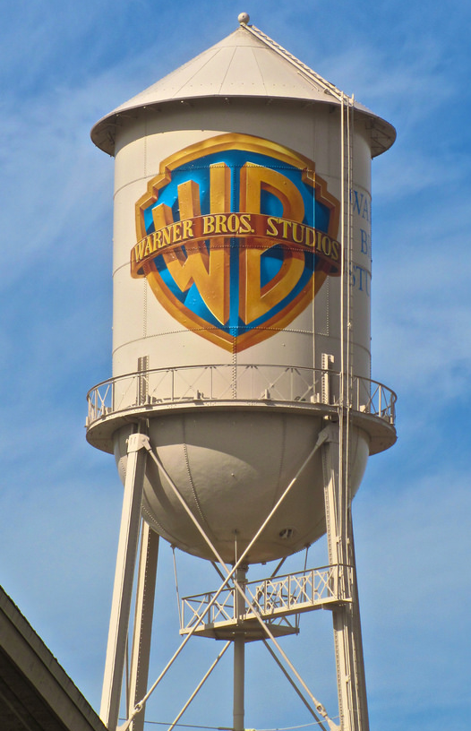
What is a
water tower?

Slide 9
A facility that cleans freshwater
so it is safe for humans
to drink
Answer

Slide 10
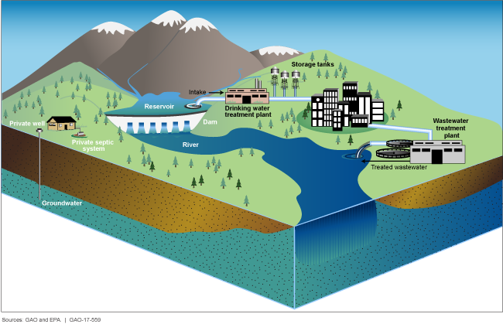
What is a drinking water
treatment plant?

Slide 11
A device that controls the flow
of water by opening and closing
Answer

Slide 12
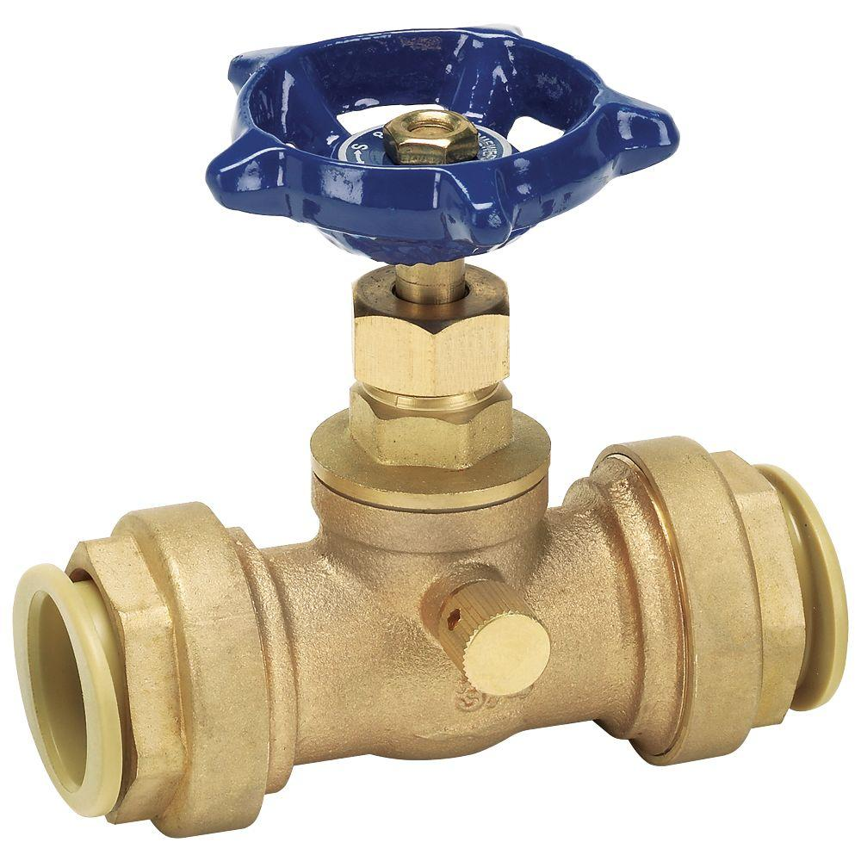
What is a valve?

Slide 13
An appliance that stores heated
water so it may be easily accessed
Answer

Slide 14
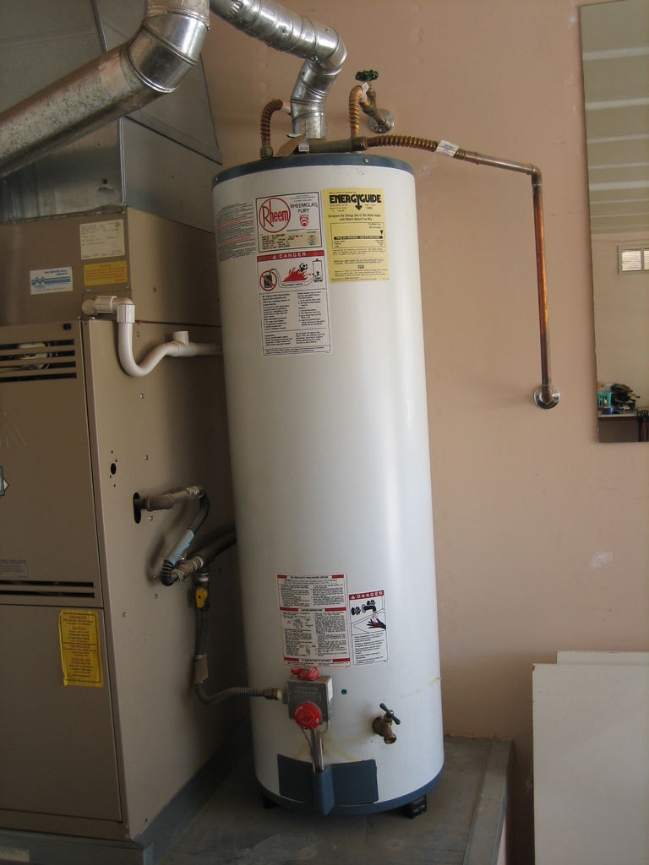
What is a
water heater?

Slide 15
A tube that is used to move
water to and from homes
Answer

Slide 16
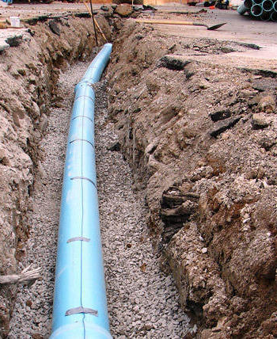
What is a pipe?

Slide 17
A large body of water where,
without human intervention, all
water would flow to
Answer

Slide 18
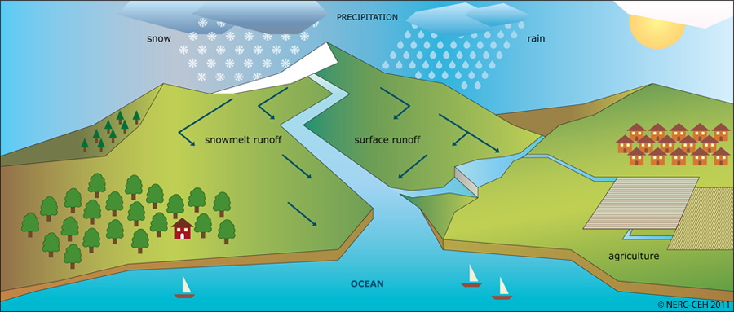
What is the ocean?

Slide 19
A series of underground pipes
that collect rainwater and deliver
it to the ocean
Answer

Slide 20
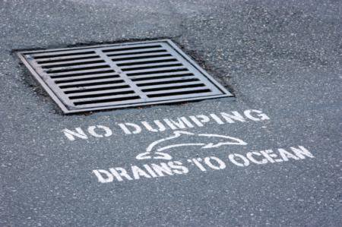
What is a storm drain?

Slide 21
A series of pipes that take waste
water away from homes
Answer

Slide 22
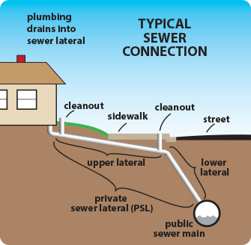
What is
a sewer?

Slide 23
A process that cleans sewer water
before releasing it into the ocean
Answer

Slide 24
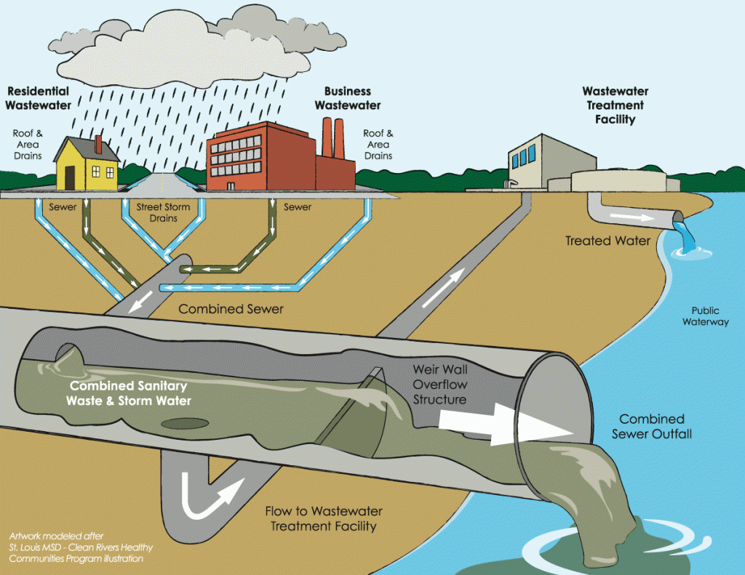
What is waste water treatment?
Notes:
If water is not treated, would instead release sewer water back into the ocean

Slide 25
The name of the waste water
treatment facility that services
homes in Los Angeles
Answer

Slide 26
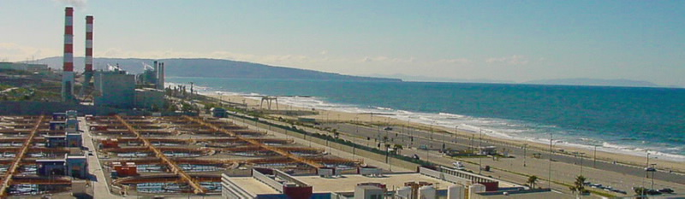
What is the Hyperion Water
Reclamation Plant?

Slide 27
A body of freshwater
Answer

Slide 28
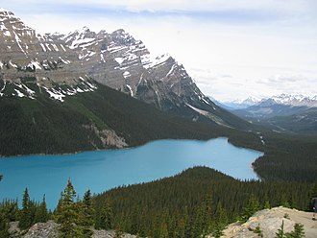
What is a lake?

Slide 29
The type of water that animals
and plants need to survive
Answer

Slide 30
What is freshwater?

Slide 31
The type of water that makes up
most of the water on earth
Answer

Slide 32
What is saltwater?

Slide 33
Water that is found stored in soil
underneath the surface
Answer

Slide 34
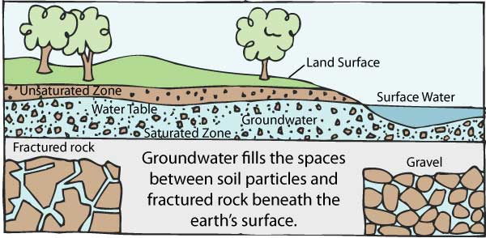
What is groundwater?

Slide 35
A large collection of groundwater
Answer

Slide 36
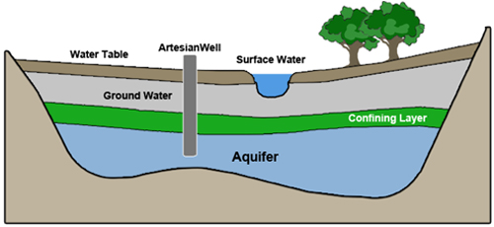
What is an aquifer?

Slide 37
A period of time where a location
does not have as much rain or
snow as is needed
Answer

Slide 38
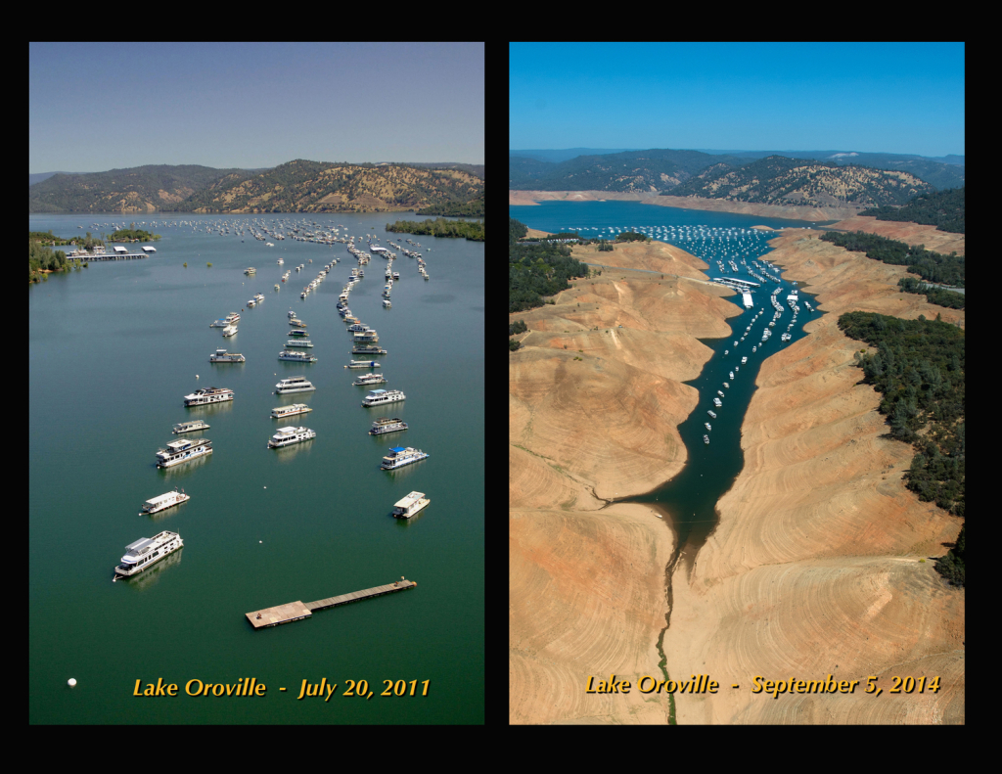
What is a drought?

Slide 39
Name at least three (3) types of
water falling down onto the surface
Answer

Slide 40
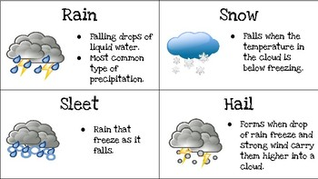
What is snow, sleet, rain, hail?

Slide 41
This is a body of water that is
visible in the sky
Answer

Slide 42
What is a cloud?

Slide 43
This is the part of the water cycle
where water heats into a gas
Answer

Slide 44
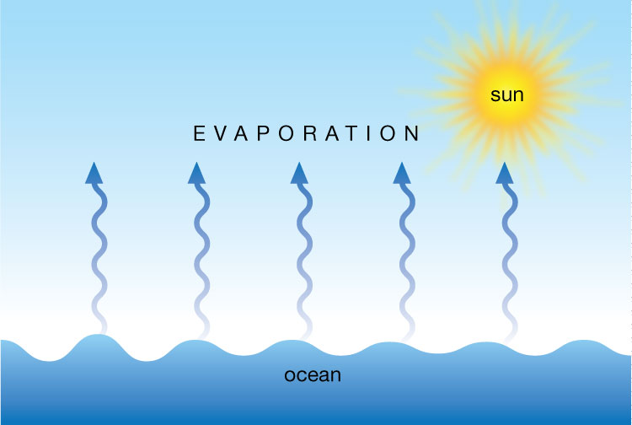
What is evaporation?

Slide 45
This is the part of the water cycle
where water vapor (gas) turns
into a liquid
Answer

Slide 46
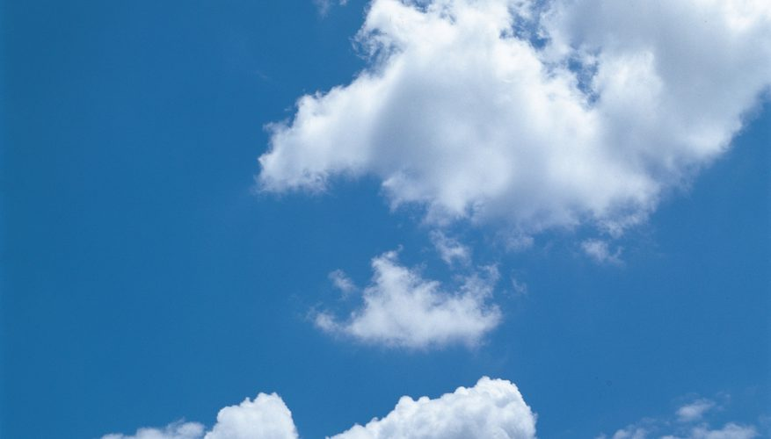
What is condensation?

Slide 47
This is the part of the water cycle
where water falls to the ground
Answer

Slide 48
What is precipitation?

Slide 49
This is a land formation where
snow accumulates, or collects, on
Answer

Slide 50
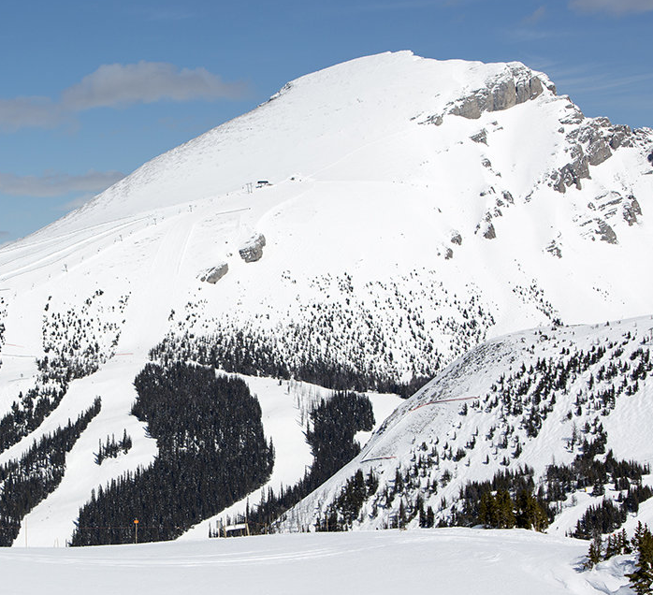
What is
a mountain?

Slide 51
This is the chemical symbol of
water
Answer

Slide 52
What is H₂O?

Slide 53
This is the name of the systems
that delivers water to Southern
California
Answer

Slide 54
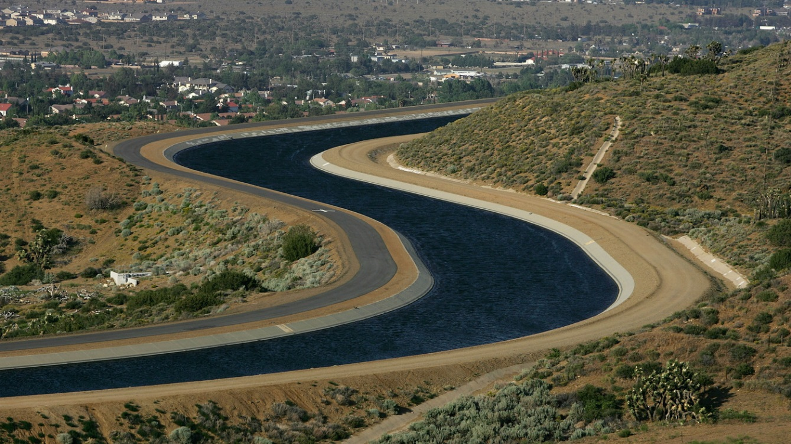
What is an aqueduct?

Slide 55
This is the name of your local
water agency
Answer

Slide 56
What is West Basin Municipal
Water District?

Slide 57
This is a process that mimics
the natural water cycle, that aims
to conserve freshwater
Answer

Slide 58
What is water recycling?

Slide 59
This is the name of West Basin’s
facility that recycles water
Answer

Slide 60
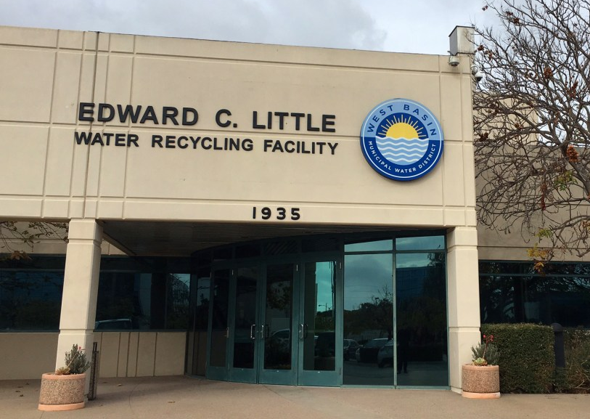
What is Edward C. Little Water
Recycling Facility?

Slide 61
This is the process of actively
trying to save water
Answer

Slide 62
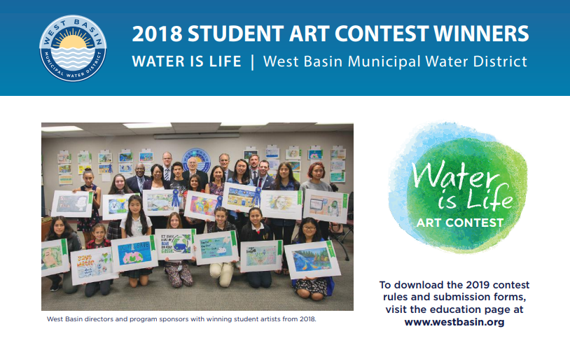
What is conservation?
Notes:
West Basin’s annual Water is Life art contest encourages 3rd-12th grade students to promote water conservation through original works of art.

